Slide 1


Credit Score with Scorecards Method
Credit Scoring and Analytics
pacmann.io
© 2022 – Pacmann AI

Slide 2
Outline
Introduction and Background
Dataset Description
Scorecards Development
Implementation Plan
Conclusion and Recommendation
References

Slide 3
Introduction and Background
Notes:
Transisi antar outline

Slide 4
Introduction and Background
PinjamPintar is a financial institution with a deep commitment to financial services.
PinjamPintar faces challenges in the lending decision-making process. This process involves manual assessments that are time-consuming and at risk of subjective bias. Not only that, the risk associated with a Non-Performing Loan (NPL) or unpaid debt is always a major concern for PinjamPintar.
One approach that can be taken is the use of credit scores or credit score prediction models.
Credit scoring is a method of evaluating the credit risk of loan applications. Using historical data and statistical techniques, credit scoring tries to isolate the effects of various applicant characteristics on delinquencies and defaults.

Slide 5
Introduction and Background
There are several development objectives of credit score prediction for PinjamPintar, namely:
- Build a technology-based application that automatically assesses loan applicants based on various factors, including credit history, income, employment, marital status, and other relevant variables.
- Identify applicants who have a high risk of defaulting on their loans, which can help reduce the risk of Non Performing Loan (NPL).
- Improve efficiency and consistency in assessing credit risk by using predictive models based on historical data and trained algorithms that enable more objective and consistent decision making.
- Transforming PinjamPintar's decision-making process from manual lending to more efficient and effective use of credit scores or credit score prediction models.

Slide 6
Dataset Description
Notes:
Transisi antar outline

Slide 7
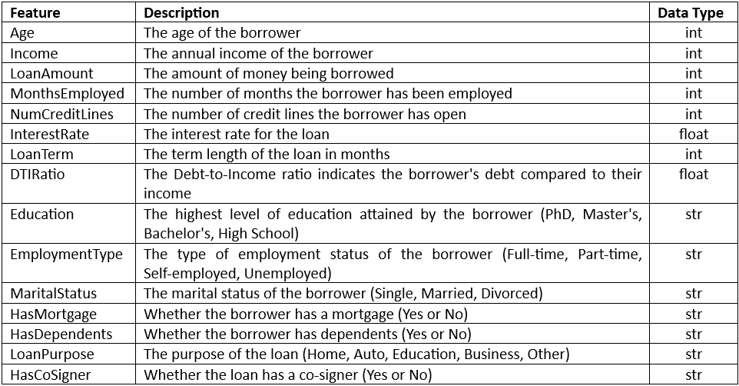
Dataset Description
The dataset comes from loan_default. This dataset has 255,347 accounts (assumption) from 18 variables, but only uses a few variables that are relevant in influencing/ evaluating loan default. The data is a collection of information that includes demographic, financial, and target variable information. The data consists of :
- 15 predictors/potential characteristics - 1 response/target variable

Slide 8
Scorecards Development
Notes:
Transisi antar outline

Slide 9
Scorecards Development
Scorecard Development Process
1. Explore Data
2. Handle Missing Values and Outliers
3. Check Correlation
4. Initial Characteristic Analysis
5. Statistical Measures
6. Check Logical Trend and Business/Operational Considerations
7. Design Scorecard
8. Choose Scorecard

Slide 10
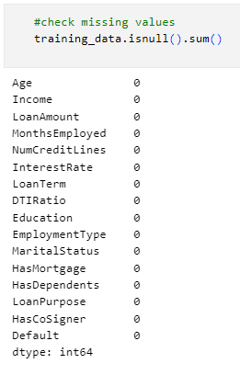
Scorecards Development
Scorecard Development Process
1. Explore Data
The data exploration stage is carried out to understand and analyze the data that will be used in model development. At this stage, simple statistics such as value distribution, mean/median, and checking the integrity of each data are carried out.
2. Handle Missing Values and Outliers
There are no missing values in the data set. This indicates that
the data is complete and there is no missing or unfilled
information in the variables.

Slide 11
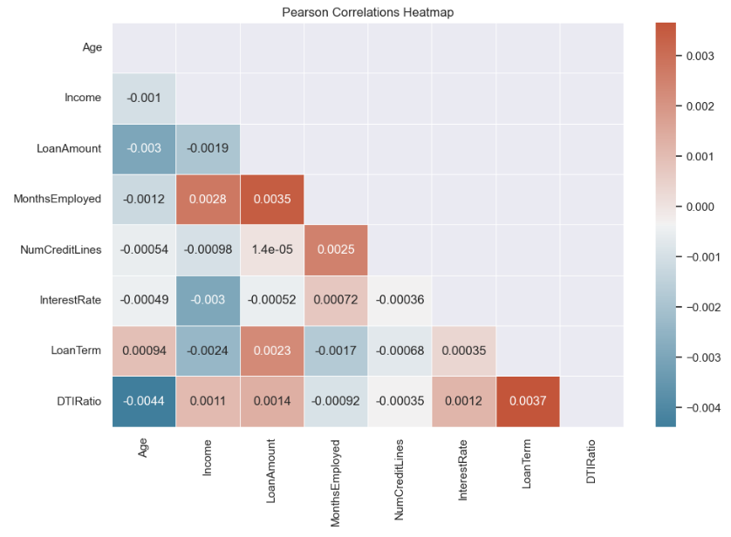
Scorecards Development
Scorecard Development Process
3. Check Correlation

Slide 12
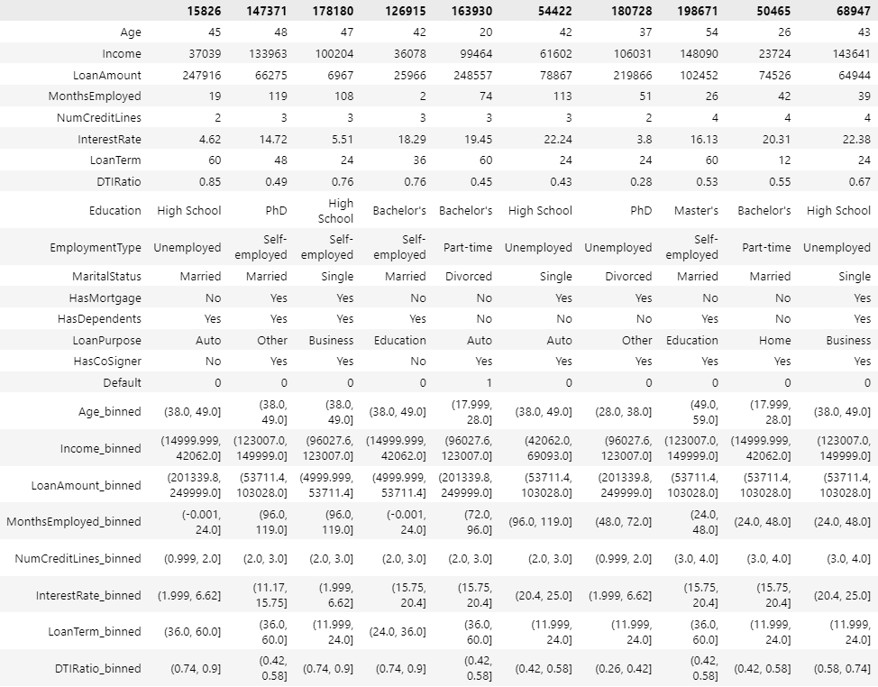
Scorecards Development
Scorecard Development Process
4. Initial Characteristic Analysis
Each characteristic/predictor is analyzed to predict the credit score or total point score of an applicant by binning the numerical predictors. Binning is the process of grouping or classifying numerical values into categories or "bins." The number of binning is 5 categories.

Slide 13
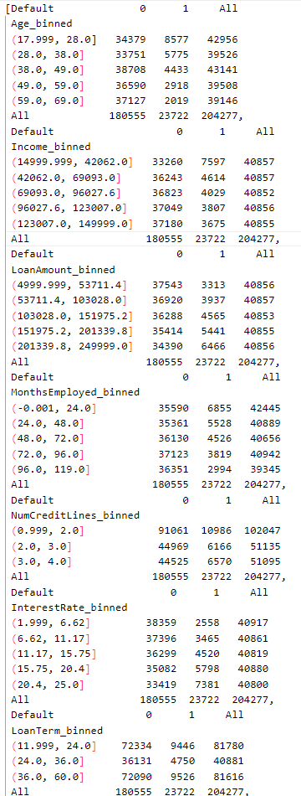
Scorecards Development
Scorecard Development Process
4. Initial Characteristic Analysis
Contingency table functions to describe or present the relationship between two or more categorical variables.

Slide 14
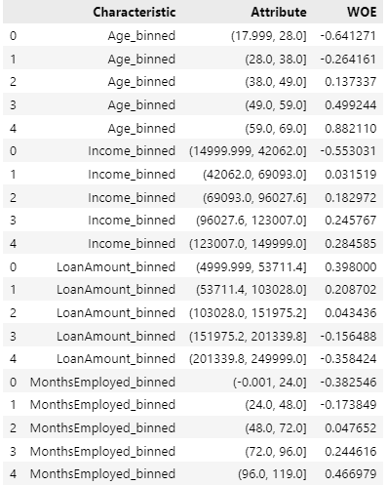
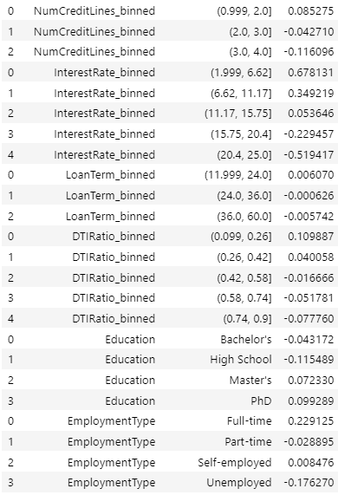
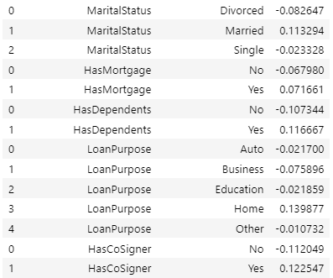
Scorecards Development
Scorecard Development Process
5. Statistical Measures
- Weight of Evidence (WOE)
WOE is used to measure the strength of each attribute in each category.

Slide 15
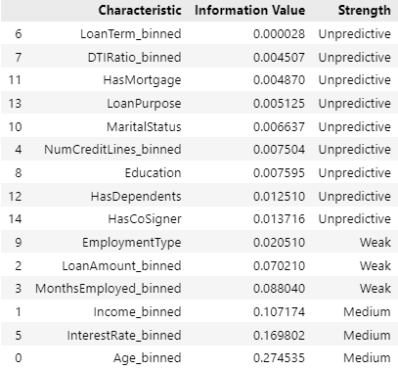
Scorecards Development
Scorecard Development Process
5. Statistical Measures
- Information Value (IV)
IV is used to measure the strength of each characteristic.

Slide 16
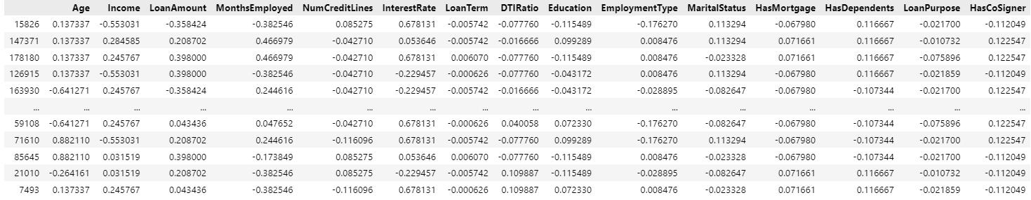
Scorecards Development
Scorecard Development Process
6. Check Logical Trend and Business/Operational Considerations
Based on the analysis of each characteristic, it can be concluded that all WOEs make business, logic and operational sense.
7. Design Scorecard
To create a scorecard design, a logistic regression model is used. To perform the modeling, not the original inputs of age, income, etc. (row input) to be used but the WOE of each attribute.

Slide 17
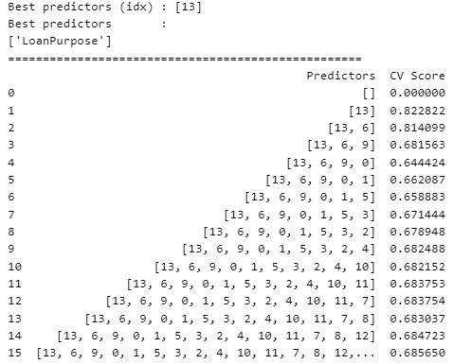
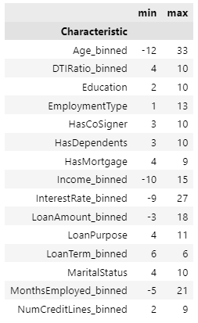
Scorecards Development
Scorecard Development Process
7. Design Scorecard

Slide 18
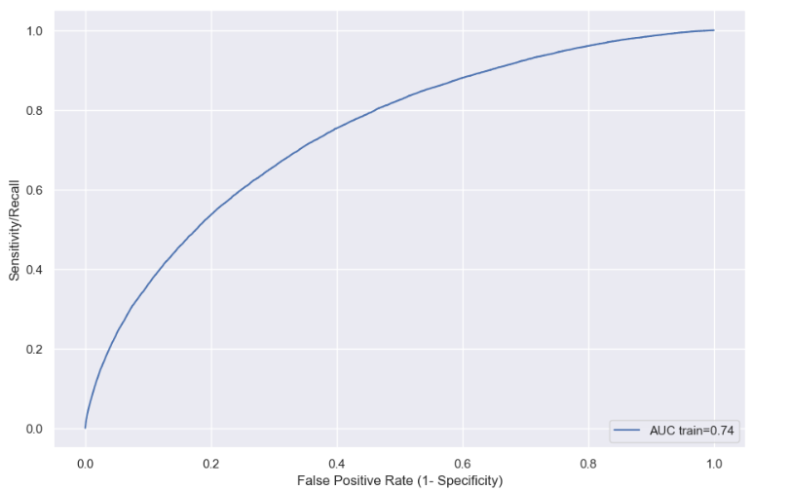
Scorecards Development
Scorecard Development Process
8. Choose Scorecard
To select the most suitable model, a number of statistical metrics are used to measure its quality. The metrics used are AUC and KS Statistic. AUC is an evaluation metric used to measure the extent to which the model can distinguish between positive (1) and negative (0) classes.

Slide 19
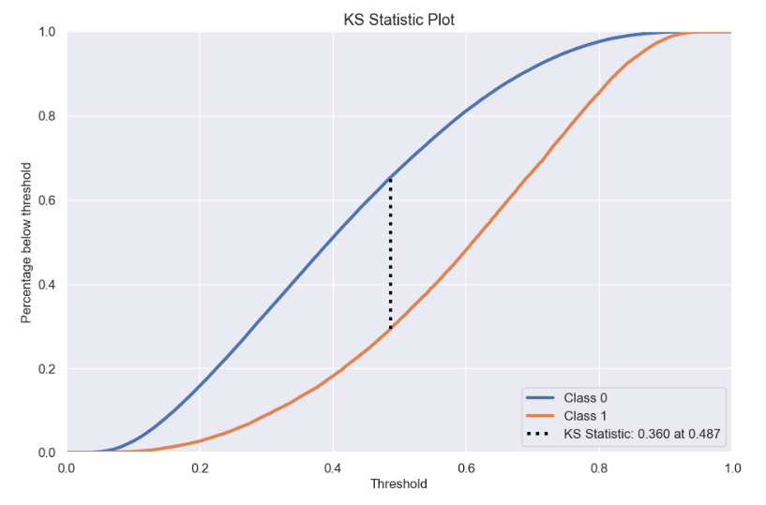
Scorecards Development
Scorecard Development Process
8. Choose Scorecard
KS Statistic measures the difference between two cumulative distribution functions, one for the positive class (1) and one for the negative class (0).

Slide 20
Implementation Plan
Notes:
Transisi antar outline

Slide 21
Implementation Plan
In the implementation plan, setting the credit score cutoff (determining the credit score threshold) to obtain key decisions in the credit risk assessment process. The credit score threshold determines whether an applicant will be approved or rejected for a loan or credit.
The selection of the cutoff score value of 150 is based on several considerations, namely based on the availability of data and score models that support the threshold. In addition, the cutoff selection is also based on the expected bad rate. This means that PinjamPintar estimates that applicants with scores below 150 have a higher or worse risk of default.

Slide 22
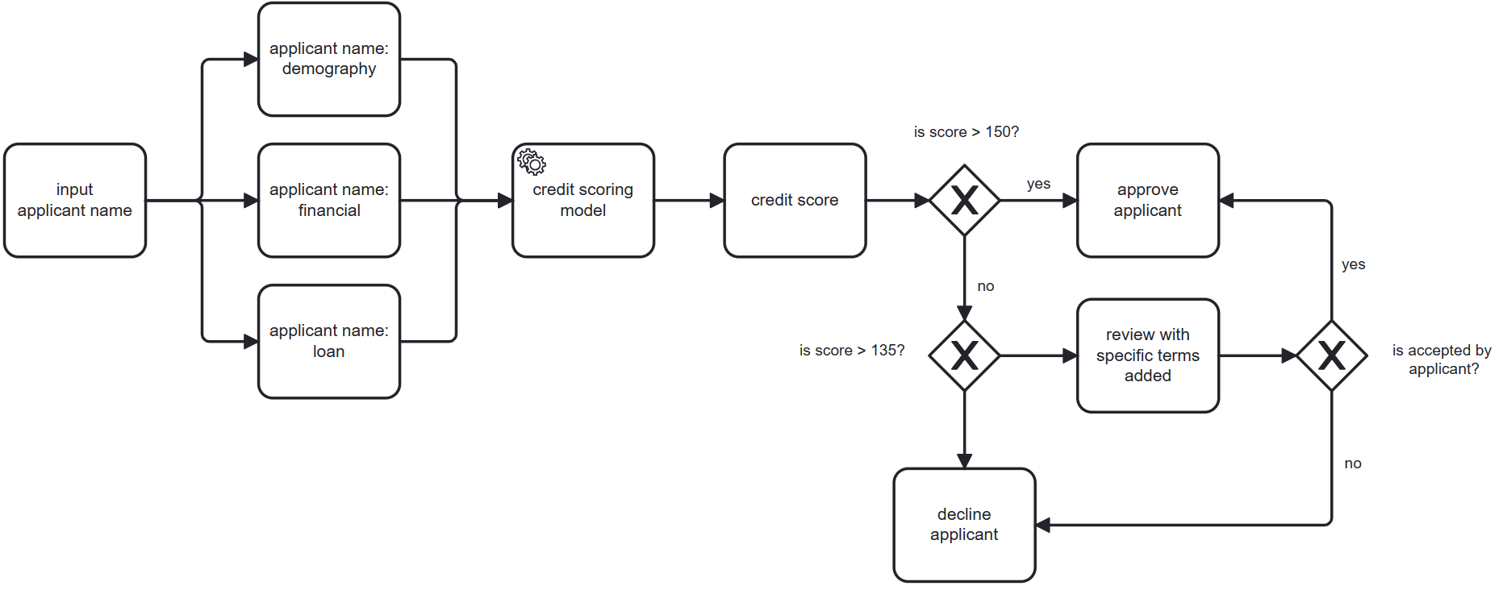
Implementation Plan
Workflow Credit Process

Slide 23
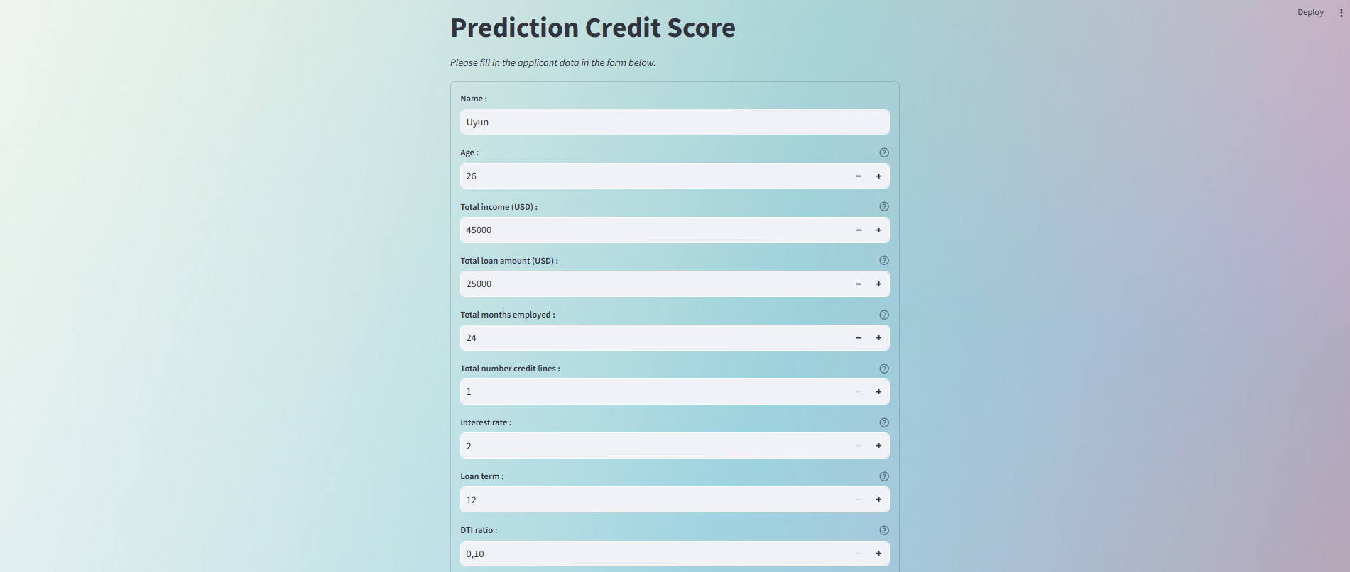
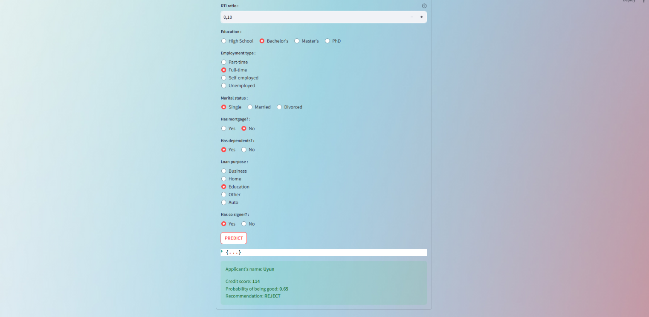
Implementation Plan
Prediction Credit Score User Interface

Slide 24
Conclusion and Recommendation
Notes:
Transisi antar outline

Slide 25
Conclusion
The logistic regression model that has been adjusted by selecting the right cut-off score is able to predict the credit score well. The model was able to distinguish between good and bad applicants with a recall rate of 68%. The overall quality of the model was rated as good with an AUC of 0.74. This indicates that the model can be used to support credit decisions well.
Based on the results of the analysis, there are several recommendations:
For risk managers: utilize credit scoring models to assess applicants' credit risk and make informed decisions on whether to approve or reject loans.
For operations team: automate the decision-making process to improve efficiency and reduce manual review of applicants.
For marketing teams: leverage models to target specific customer segments more effectively and develop focused marketing campaigns to acquire customers with lower default risk.
For the next project recommendation is to try using other models such as decision tree, SVM or KNN to compare their performance in predicting credit scores.

Slide 26
Reference
Alec Zhixiao Lin, PayPal Credit, Timonium, MD. 2014. Expanding the Use of Weight of Evidence and Information Value to Continuous Dependent Variables for Variable Reduction and Scorecard Development. Dept. of Mathematics & Statistics, Univ of Maryland, Baltimore, MD.
Christine Bolton. 2009. Logistic regression and its application in credit scoring. University of Pretoria.
Loretta J. Mester. 1997. What Is The Point Of Credit Scoring? Business review (Federal Reserve Bank of Philadelphia).
McNamara. 2016. SDS/MTH 291: Lecture Notes.
Naeem Siddiqi. 2006. Credit Risk Scorecards Developing and Implementing Intelligent Credit Scoring.

Slide 27
Thank You
Notes:
Transisi antar outline

